Slide 1


Area calculator
This app is mainly for calculation of the area of the objects can be used in various purposes

Slide 2

How does it work?
It cuts the part of the object from the picture and calculates its area based on properties
Important questions

Slide 3

Main goal:
To show our knowledge in practical way using various libraries of python and demonstrate our clear understanding of the syntax

Slide 4
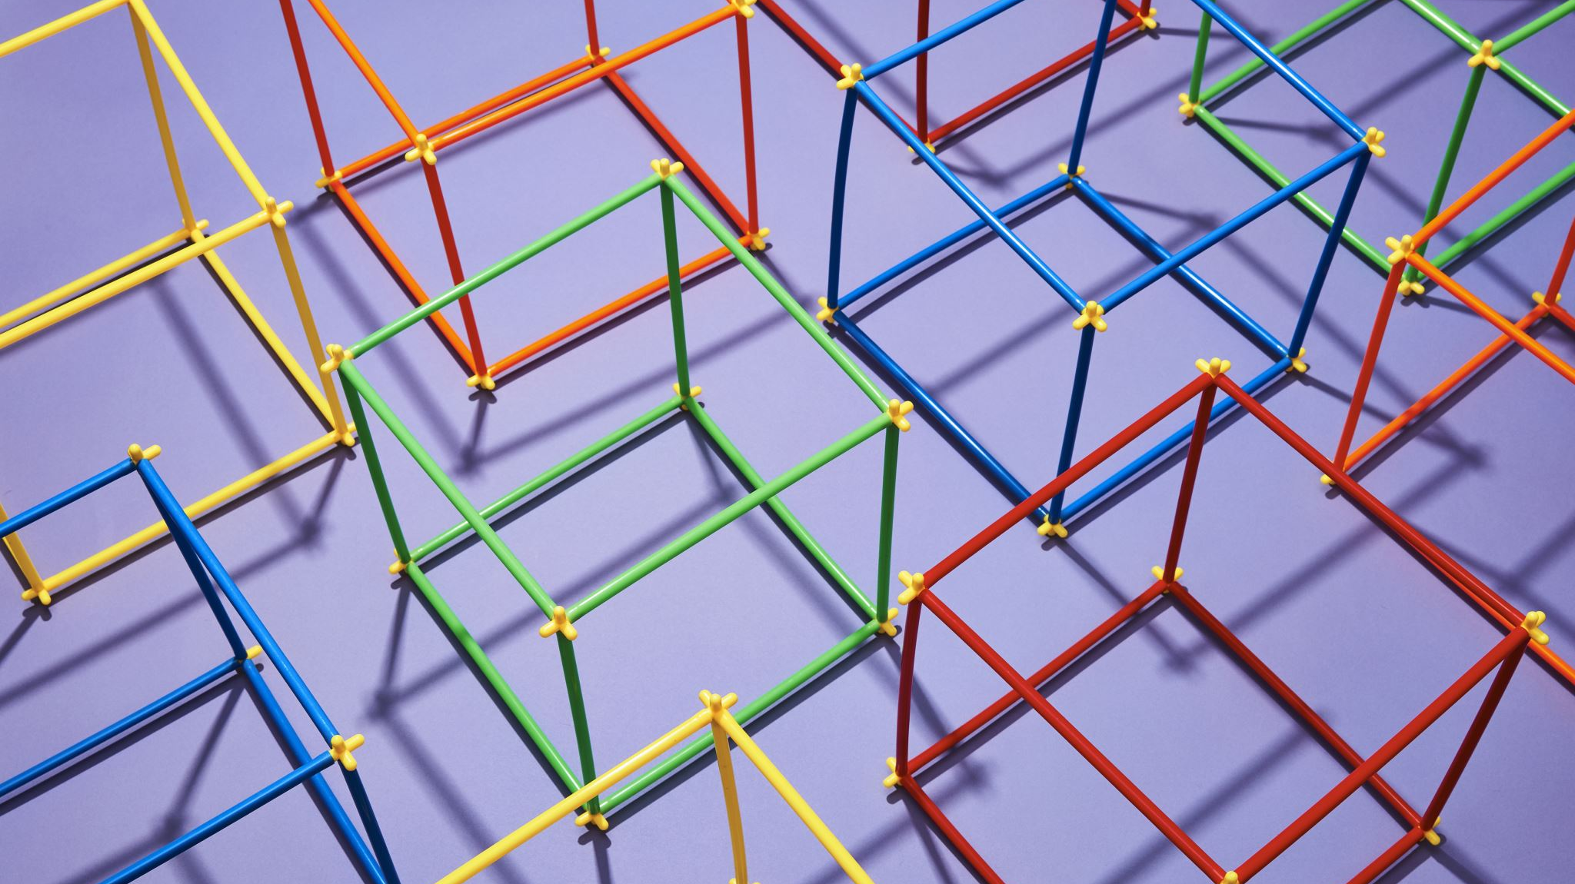
How can we use this program?
1.start
2.user select 1 or 2 (open camera or input file)
3.user get the number of pixels on the screen
4.stop
Algorithm

Slide 5
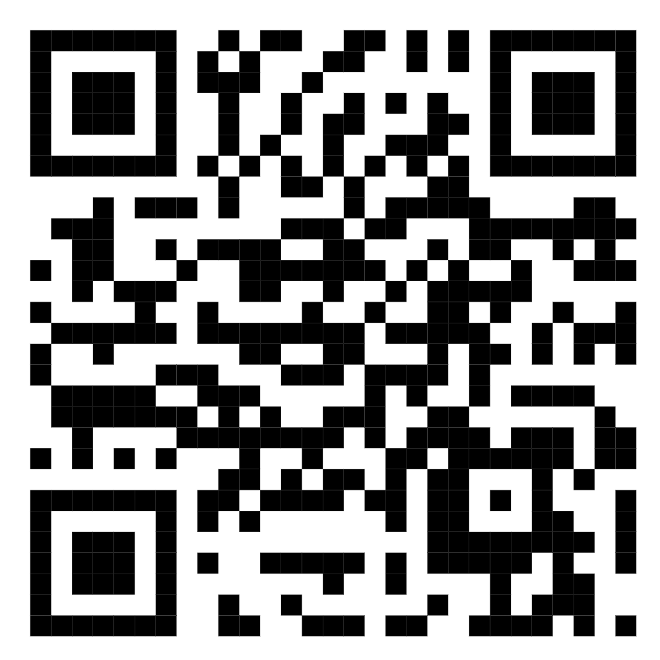
CODE:

Slide 6
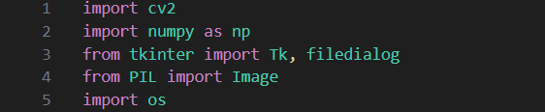
First part: importing libraries

Slide 7
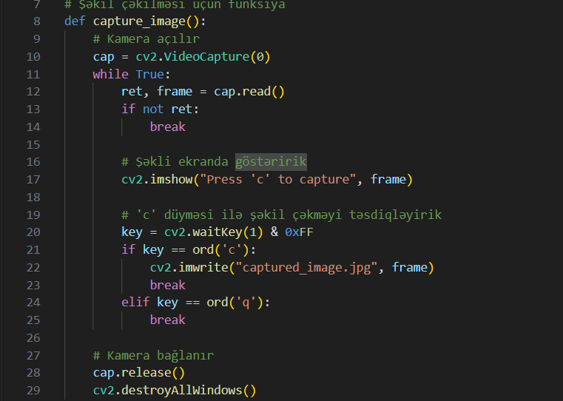
Second part: Capture Image

Slide 8
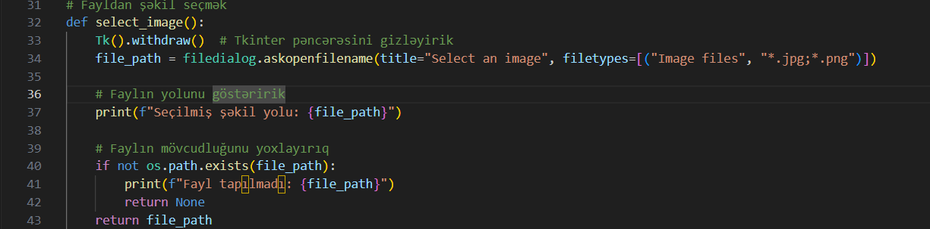
Third part: Select Image

Slide 9
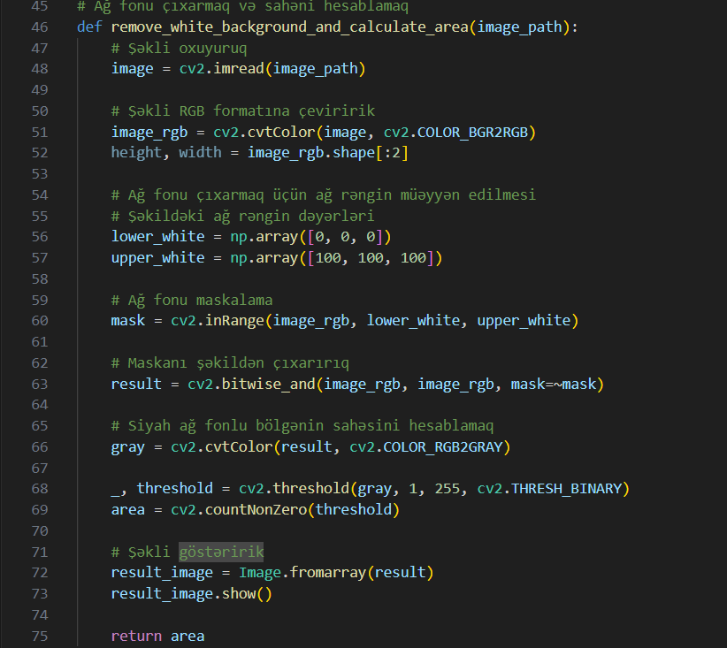
Fourth part: remove black background

Slide 10
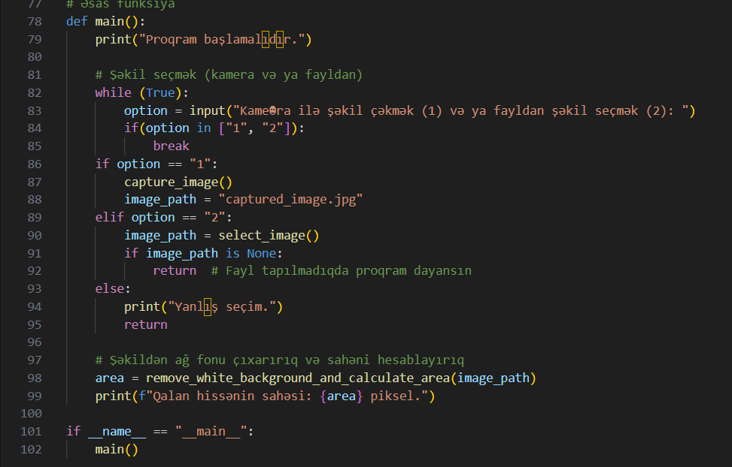
Fifth part:main part

Slide 11

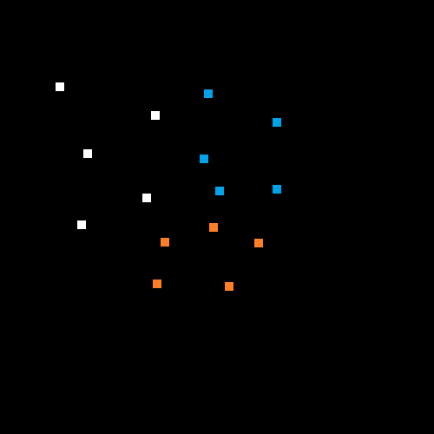
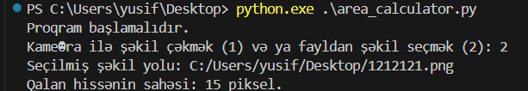
Example with Paint
50x50

Slide 12
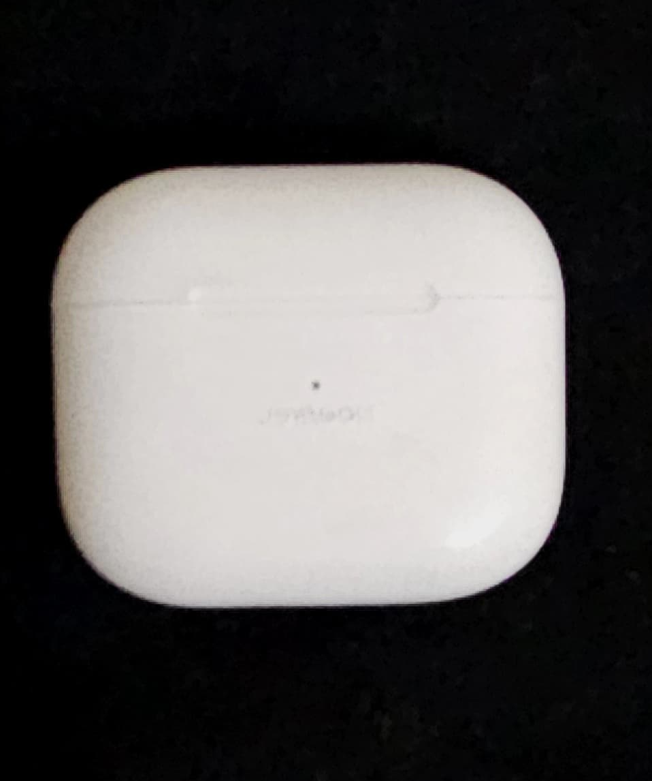
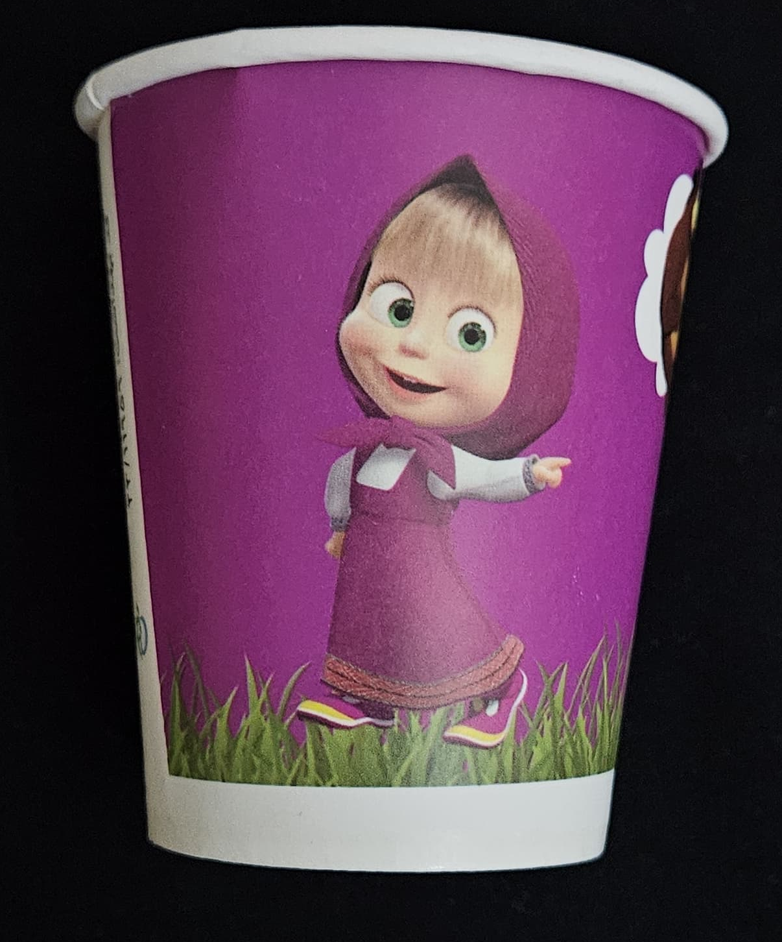
Examples:
What do you think ? How many pixels in these images?
Second image
First image

Slide 13


